Slide 2
Clean Code: Introduction

Slide 3

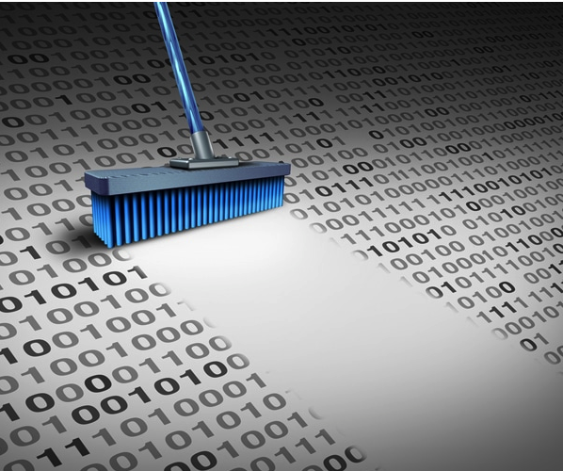
What Is Clean Code?

Slide 4

What famous People say about Clean Code:
Grady Booch
Bjarne Stroustrup
Ward Cunnihgham
Michael Feathers

Slide 5
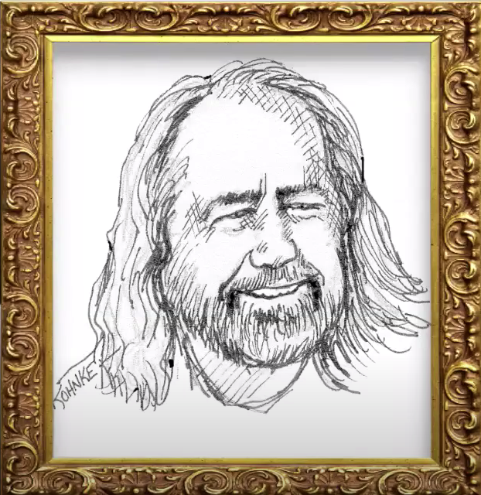
Grady booch
Clean Code is simple and direct.
Clean Code reads like well-written prose.
Clean code never obscures the designer’s intent but rather is full of crisp abstractions and straightforward lines of control.
Object Orientied Design and Analysis

Slide 6
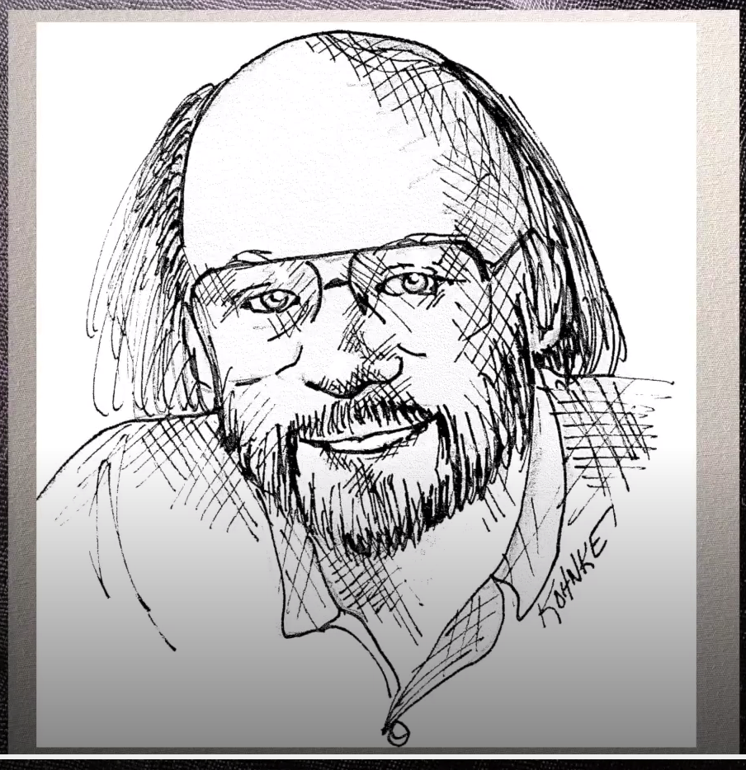
Bjarne Stroustrup
I like my code to be elegant and efficient.
The logic should be straightforward to make it hard for bugs to hide, the dependencies minimal to ease maintenance, error handling complete according to an articulated strategy, and performance close to optimal so as not to tempt people to make the code messy with unprincipled optimizations.
Clean code does one thing well.
Inventor of C++

Slide 7
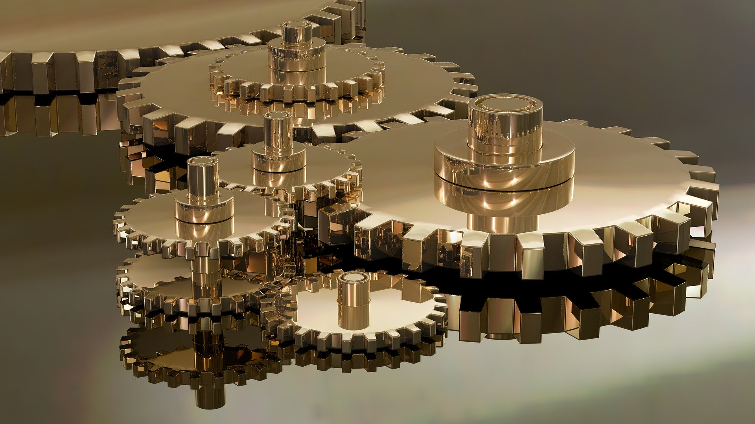
Elegant & efficient
Straightforward logic
Minimal dependencies
Complete error handling
Does one thing well

Slide 8
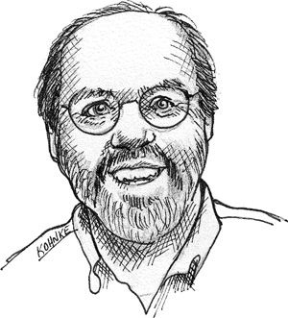
Ward Cunningham
You know you are reading clean code, when every routine that you read is pretty much what you expected.
You can call it beautiful code when the code also makes it look like the language was made for the problem.
Inventor of Wiki

Slide 9
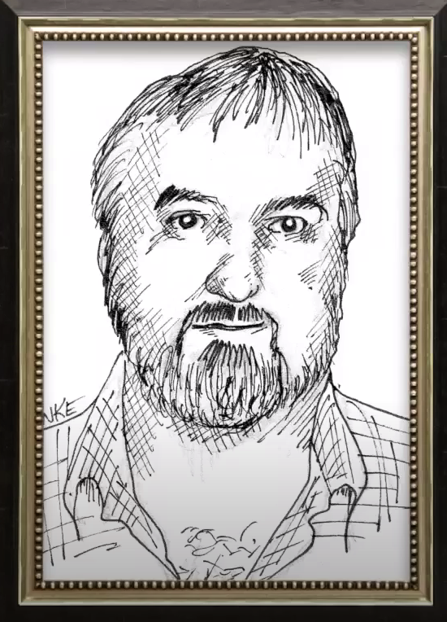
Michael feathers
Clean code always looks like it was written by someone who cares.
Working Effectively with Legacy Code

Slide 10

What is clean code?
Reads like well-written prose
Does one thing well
Every routine does what you expected
Written by someone who cares

Slide 11
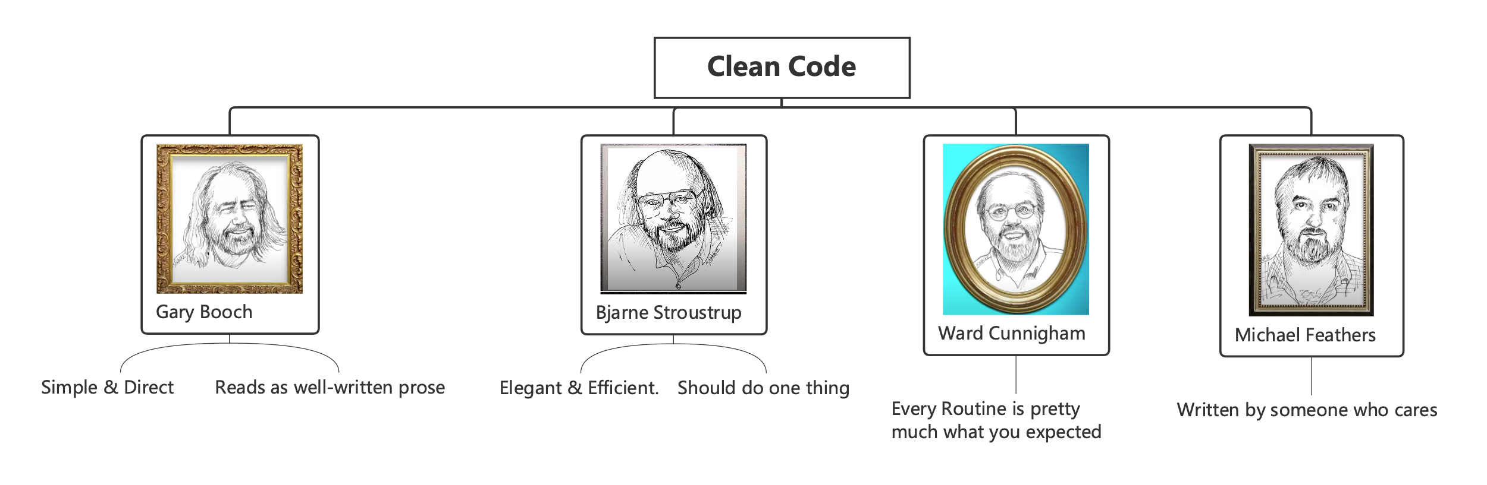

Slide 12
How do we get there?

Slide 13
The boy scout rule
Robert B. Powell (inspirational figure for the scouting movement)
Leave the world better than you found it!

Slide 14
The boy scout rule
Robert C. Martin (author of Clean Code)
Leave your code better than you found it!

Slide 15
Sources
Clean Code - A Handbook of Agile Software Craftsmanship. The Object Mentors: Robert C. Martin et al.
Clean Architecture: A Craftsman’s Guide to Software Structure and Design. Robert C. Martin
C++ Core Guidelines. Bjarne Stroustrup, Herb Sutter (editors)
…

Slide 16


